Slide 1
Teaching Plan Presentation
Syuzanna Orujyan
West Coast University

Slide 2
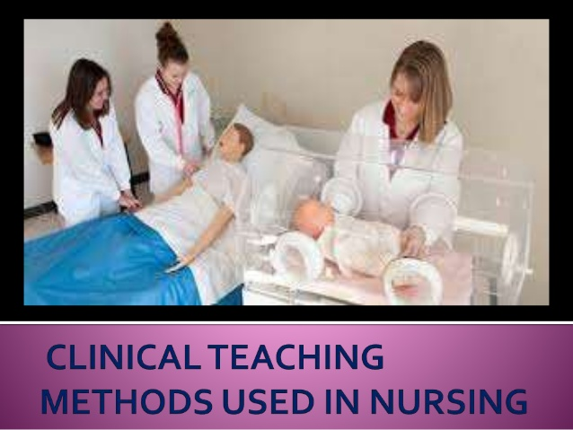
Nursing II Clinical
This course covers nursing practices in the public health sector.
Notes:
The purpose of clinical nursing is to equip a student with relevant infromation about the health of the general public and how to handle any medical emergency. The main agenda being strategic planning in the bid to save lives and offer quality health care.

Slide 3


Learning Objectives
Assess Preventive measures that can enable improve public health
Equipping the learner with adequate skills to promote nursing profession
Promotion of equity in public health
Apply evidence-based practices to solve different issues
Notes:
Determining the core aspects of public health like community development primary health care
students should be able to apply evidence-based practices to solve different issues affecting the health of the public

Slide 4
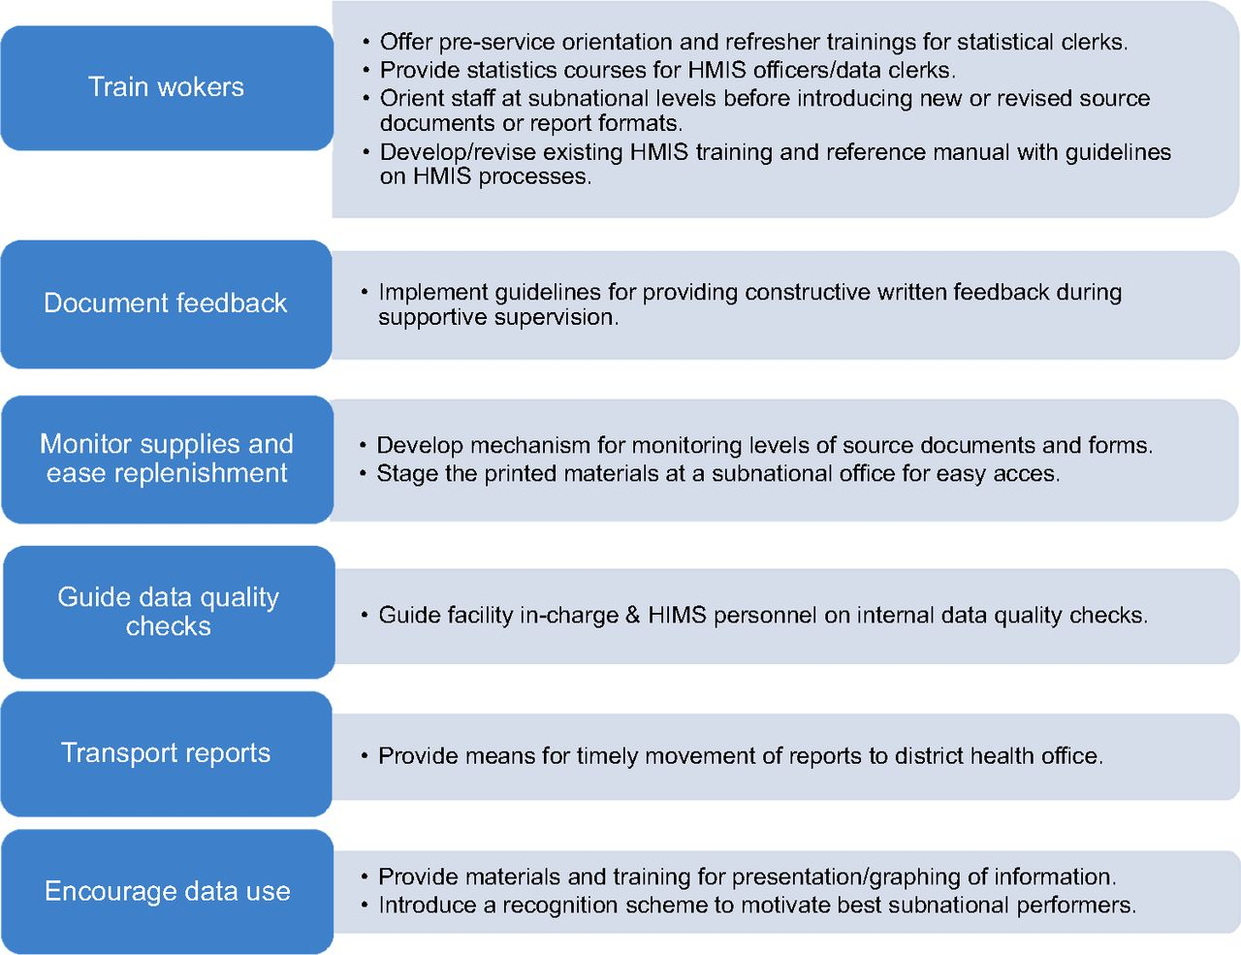
The Level Of Instruction
Notes:
The chain of instructions starts fro the superior to the juniors, the tutor gives directions and the students follow.

Slide 5


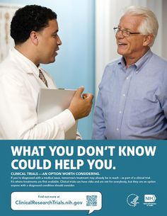
Teaching Strategies and Learning Activities
Pre-class assignments
Lecturing
Q&A session
Code calling
Notes:
Pre-class assignments to enable familiarize students with topics and terms used within the course.
Lecturing will equip the learner with expounded knowledge and notes of the tutor, it also offers an opportunity for Q&A allowing the better understanding of concepts taught or researched information.
Use of code calling enables the lecturers gage the comprehension of information by the students. The activity raises confidence in some but in others lowers self-esteem affect their performance
Personal reflections allow comprehension of information, henceforth applying it in day to day activities. Tutors encourage students to express their thoughts on current affairs and epidemics and solve the through learnt information.
Peer teaching, group work, reading quizzes, journal clubs among others assist the student account for every strategy he/se resolves to us.

Slide 6


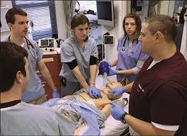
Evaluation Process
Use of assessment tests, written projects and essays as a group and individuals.
Notes:
The use of assessment tests which include topical multi-choice questions and essays, group and individual projects, written and oral tests at the end of the course.

Slide 7
The Rubric
Assignment requirements | Excellent (80-100) | Satisfactory (60-79) | Poor (40-59)
Thesis and topic sentences | Well presented thesis and topic sentences | Average presentation of thesis and topic sentence | No thesis and poorly presented topic sentence or none
Grammar, formatting, and structuring | Excellent grammar, structure and format writing. | Good grammar, structure, and format writing. | Poor grammar, structure, and format writing.
Application of evidence-based practice | The student has applied EBP principles excellently. | The student has applied EPB principles satisfactorily. | The student has not applied EBP principles.
Notes:
The rubric helps in the grading of student on how well they have understood the concepts taught in class.

Slide 8
References
Fertszt, G. Joan, D., Christine, M., & Kattherine, C. (2017). Creative strategies for teaching millenial nursing students. Nurse Educator, 46(6), 275-276.
Horntvedt, M. T., Nordsteien, A., Fermann, T., & Severinsson, E. (2018). Strategies for teaching Evidence-based practice in nursing education: A thematic literature review. BMC Medical Education, 18(172), 1-11.

